Slide 1
Introduction to Ohm’s Law

Slide 2
By the end of this lesson you will be able to:
Describe the relationships between current, voltage and resistance.
Explain what Ohm's Law is.
Demonstrate how to rearrange Ohm's Law equation.

Slide 3

There is an extremely important relationship in electricity that we call Ohm's Law.
Ohm's Law links the current, the resistance and the voltage of a circuit together. It's an incredibly useful tool for anyone who needs to do calculations involving circuits.

Slide 4
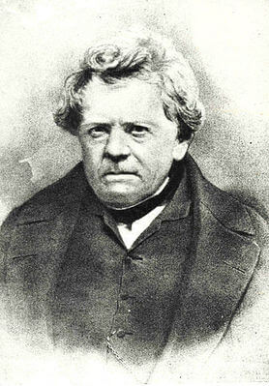
Ohm's Law was developed in the 1800s.
The physicist Georg Ohm invented Ohm's Law. He carried out many experiments to find this law and published his findings in 1827.
We can use Ohm's Law to find the resistance, voltage or current of a circuit.

Slide 5
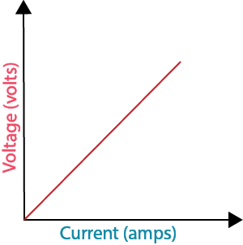
Ohm's Law states that the voltage of a circuit is directly proportional to the current of the circuit.
A directly proportional relationship means that changes that happen to one variable will happen to the other.
So what Ohm's Law states is that increasing voltage will increase the current, and decreasing current will decrease the voltage.

Slide 6
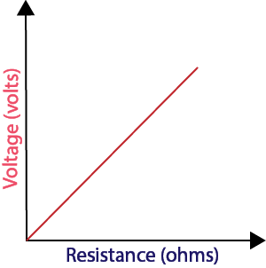
Voltage is also directly proportional to resistance.
A high voltage is caused by a high resistance, and a low voltage is caused by a low resistance (for the same value of current).

Slide 7
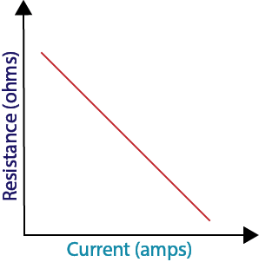
The final step here is that current is inversely proportional to resistance.
An inversely proportional relationship means that if one value decreases, the other will increase.
If the resistance is increased, the current will decrease, and higher currents occur when resistance is smaller.

Slide 8
It is difficult to predict change if all three values are changing.
This is why we usually make sure one value is kept constant.
The constant (unchanging) value for Ohm's Law is usually resistance. Resistance only changes if the circuit itself is altered, so most calculations have a constant resistance.
If we change the resistance, the voltage will be constant, because this depends on the power supply. It is difficult to keep a constant current.

Slide 9
Ohm's Law can be expressed as an equation!
The relationship between current, voltage and resistance can be expressed as:
V=I×R
This means that voltage (V) is equal to current (I) multiplied by resistance (R). It is the most important formula in the study of electricity!

Slide 10
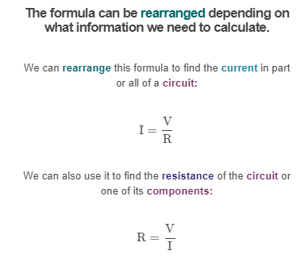


Slide 11
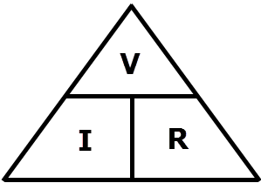
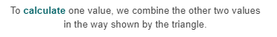
We can represent this relationship with a triangle.

Slide 12
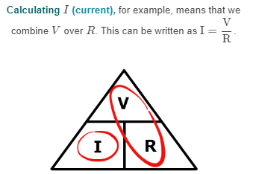

Slide 13
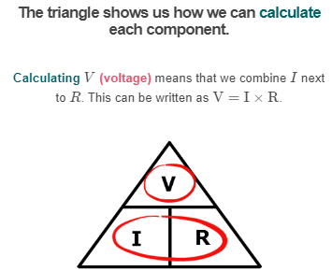

Slide 14
